Slide 1
System Security and Protection

Slide 2
The Content is prepared with the help of existing text books mentioned below:
References:
Silberschatz, Abraham, Peter B. Galvin, and Greg Gagne. Operating system concepts. Wiley Publishing, 2013.
Stallings, William. Operating Systems 5th Edition. Pearson Education India, 2006.
Tannenbaum, Andrew S. "Modern Operating Systems, 2009."

Slide 3
Protection

Slide 4
Goals of Protection
In one protection model, computer consists of a collection of objects, hardware or software
Each object has a unique name and can be accessed through a well-defined set of operations
Protection problem - ensure that each object is accessed correctly and only by those processes that are allowed to do so

Slide 5
Principles of Protection
Guiding principle – principle of least privilege
Programs, users and systems should be given just enough privileges to perform their tasks
Limits damage if entity has a bug, gets abused
Can be static (during life of system, during life of process)
Or dynamic (changed by process as needed) – domain switching, privilege escalation
“Need to know” a similar concept regarding access to data

Slide 6
Principles of Protection (Cont.)
Must consider “grain” aspect
Rough-grained privilege management easier, simpler, but least privilege now done in large chunks
For example, traditional Unix processes either have abilities of the associated user, or of root
Fine-grained management more complex, more overhead, but more protective
File ACL lists, RBAC
Domain can be user, process, procedure

Slide 7
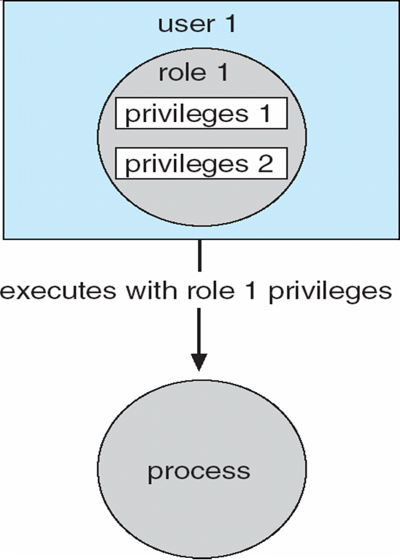
Access Control
Protection can be applied to non-file resources
Oracle Solaris 10 provides role-based access control (RBAC) to implement least privilege
Privilege is right to execute system call or use an option within a system call
Can be assigned to processes
Users assigned roles granting access to privileges and programs
Enable role via password to gain its privileges
Similar to access matrix

Slide 8
Revocation of Access Rights
Various options to remove the access right of a domain to an object
Immediate vs. delayed
Selective vs. general
Partial vs. total
Temporary vs. permanent
Access List – Delete access rights from access list
Simple – search access list and remove entry
Immediate, general or selective, total or partial, permanent or temporary

Slide 9
Revocation of Access Rights (Cont.)
Capability List – Scheme required to locate capability in the system before capability can be revoked
Reacquisition – periodic delete, with require and denial if revoked
Back-pointers – set of pointers from each object to all capabilities of that object (Multics)
Indirection – capability points to global table entry which points to object – delete entry from global table, not selective (CAL)
Keys – unique bits associated with capability, generated when capability created
Master key associated with object, key matches master key for access
Revocation – create new master key
Policy decision of who can create and modify keys – object owner or others?

Slide 10
Capability-Based Systems
Hydra
Fixed set of access rights known to and interpreted by the system
i.e. read, write, or execute each memory segment
User can declare other auxiliary rights and register those with protection system
Accessing process must hold capability and know name of operation
Rights amplification allowed by trustworthy procedures for a specific type
Interpretation of user-defined rights performed solely by user's program; system provides access protection for use of these rights
Operations on objects defined procedurally – procedures are objects accessed indirectly by capabilities
Solves the problem of mutually suspicious subsystems
Includes library of prewritten security routines

Slide 11
Capability-Based Systems (Cont.)
Cambridge CAP System
Simpler but powerful
Data capability - provides standard read, write, execute of individual storage segments associated with object – implemented in microcode
Software capability -interpretation left to the subsystem, through its protected procedures
Only has access to its own subsystem
Programmers must learn principles and techniques of protection

Slide 12
Security

Slide 13
The Security Problem
System secure if resources used and accessed as intended under all circumstances
Unachievable
Intruders (crackers) attempt to breach security
Threat is potential security violation
Attack is attempt to breach security
Attack can be accidental or malicious
Easier to protect against accidental than malicious misuse

Slide 14
Security Violation Categories
Breach of confidentiality
Unauthorized reading of data
Breach of integrity
Unauthorized modification of data
Breach of availability
Unauthorized destruction of data
Theft of service
Unauthorized use of resources
Denial of service (DOS)
Prevention of legitimate use

Slide 15
Security Violation Methods
Masquerading (breach authentication)
Pretending to be an authorized user to escalate privileges
Replay attack
As is or with message modification
Man-in-the-middle attack
Intruder sits in data flow, masquerading as sender to receiver and vice versa
Session hijacking
Intercept an already-established session to bypass authentication

Slide 16
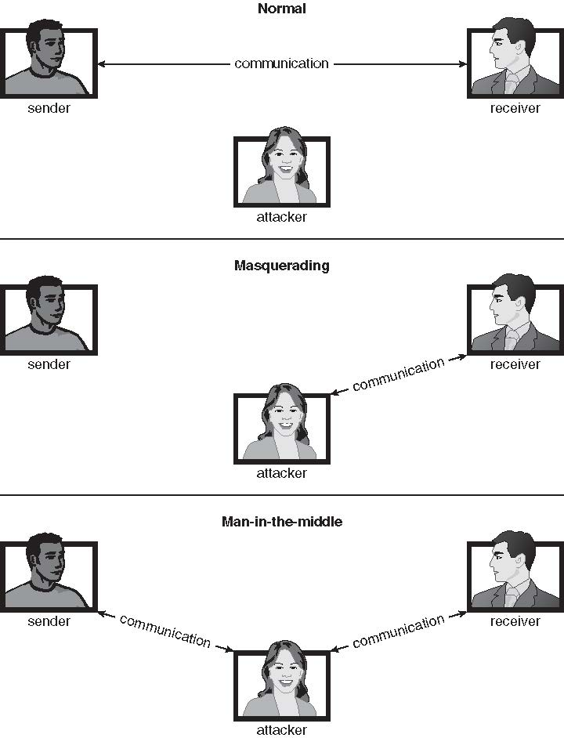
Standard Security Attacks

Slide 17
Security Measure Levels
Impossible to have absolute security, but make cost to perpetrator sufficiently high to deter most intruders
Security must occur at four levels to be effective:
Physical
Data centers, servers, connected terminals
Human
Avoid social engineering, phishing, dumpster diving
Operating System
Protection mechanisms, debugging
Network
Intercepted communications, interruption, DOS
Security is as weak as the weakest link in the chain
But can too much security be a problem?

Slide 18
Program Threats
Many variations, many names
Trojan Horse
Code segment that misuses its environment
Exploits mechanisms for allowing programs written by users to be executed by other users
Spyware, pop-up browser windows, covert channels
Up to 80% of spam delivered by spyware-infected systems
Trap Door
Specific user identifier or password that circumvents normal security procedures
Could be included in a compiler
How to detect them?

Slide 19
Program Threats (Cont.)
Logic Bomb
Program that initiates a security incident under certain circumstances
Stack and Buffer Overflow
Exploits a bug in a program (overflow either the stack or memory buffers)
Failure to check bounds on inputs, arguments
Write past arguments on the stack into the return address on stack
When routine returns from call, returns to hacked address
Pointed to code loaded onto stack that executes malicious code
Unauthorized user or privilege escalation

Slide 20
System and Network Threats
Some systems “open” rather than secure by default
Reduce attack surface
But harder to use, more knowledge needed to administer
Network threats harder to detect, prevent
Protection systems weaker
More difficult to have a shared secret on which to base access
No physical limits once system attached to internet
Or on network with system attached to internet
Even determining location of connecting system difficult
IP address is only knowledge

Slide 21
System and Network Threats (Cont.)
Port scanning
Automated attempt to connect to a range of ports on one or a range of IP addresses
Detection of answering service protocol
Detection of OS and version running on system
nmap scans all ports in a given IP range for a response
nessus has a database of protocols and bugs (and exploits) to apply against a system
Frequently launched from zombie systems
To decrease trace-ability

Slide 22
System and Network Threats (Cont.)
Denial of Service
Overload the targeted computer preventing it from doing any useful work
Distributed denial-of-service (DDOS) come from multiple sites at once
Consider the start of the IP-connection handshake (SYN)
How many started-connections can the OS handle?
Consider traffic to a web site
How can you tell the difference between being a target and being really popular?
Accidental – CS students writing bad fork() code
Purposeful – extortion, punishment

Slide 23
Cryptography as a Security Tool
Broadest security tool available
Internal to a given computer, source and destination of messages can be known and protected
OS creates, manages, protects process IDs, communication ports
Source and destination of messages on network cannot be trusted without cryptography
Local network – IP address?
Consider unauthorized host added
WAN / Internet – how to establish authenticity
Not via IP address

Slide 24
Cryptography
Means to constrain potential senders (sources) and / or receivers (destinations) of messages
Based on secrets (keys)
Enables
Confirmation of source
Receipt only by certain destination
Trust relationship between sender and receiver

Slide 25
Encryption
Constrains the set of possible receivers of a message
Encryption algorithm consists of
Set K of keys
Set M of Messages
Set C of ciphertexts (encrypted messages)
A function E : K → (M→C). That is, for each k ∈ K, E_{k} is a function for generating ciphertexts from messages
Both E and E_{k} for any k should be efficiently computable functions
A function D : K → (C → M). That is, for each k ∈ K, D_{k} is a function for generating messages from ciphertexts
Both D and D_{k} for any k should be efficiently computable functions

Slide 26
Asymmetric Encryption
Public-key encryption based on each user having two keys:
public key – published key used to encrypt data
private key – key known only to individual user used to decrypt data
Must be an encryption scheme that can be made public without making it easy to figure out the decryption scheme
Most common is RSA block cipher
Efficient algorithm for testing whether or not a number is prime
No efficient algorithm is know for finding the prime factors of a number

Slide 27
Asymmetric Encryption (Cont.)
Formally, it is computationally infeasible to derive k_{d,N} from k_{e,N}, and so k_{e} need not be kept secret and can be widely disseminated
k_{e} is the public key
k_{d} is the private key
N is the product of two large, randomly chosen prime numbers p and q (for example, p and q are 512 bits each)
Encryption algorithm is E_{ke,N}(m) = m^{ke} mod N, where k_{e} satisfies k_{e}k_{d} mod (p−1)(q −1) = 1
The decryption algorithm is then D_{kd,N}(c) = c^{kd} mod N

Slide 28
Asymmetric Encryption Example
For example. make p = 7and q = 13
We then calculate N = 7∗13 = 91 and (p−1)(q−1) = 72
We next select k_{e} relatively prime to 72 and< 72, yielding 5
Finally, we calculate k_{d} such that k_{e}k_{d} mod 72 = 1, yielding 29
We how have our keys
Public key, k_{e,N} = 5, 91
Private key, k_{d,N} = 29, 91
Encrypting the message 69 with the public key results in the cyphertext 62
Cyphertext can be decoded with the private key
Public key can be distributed in cleartext to anyone who wants to communicate with holder of public key

Slide 29
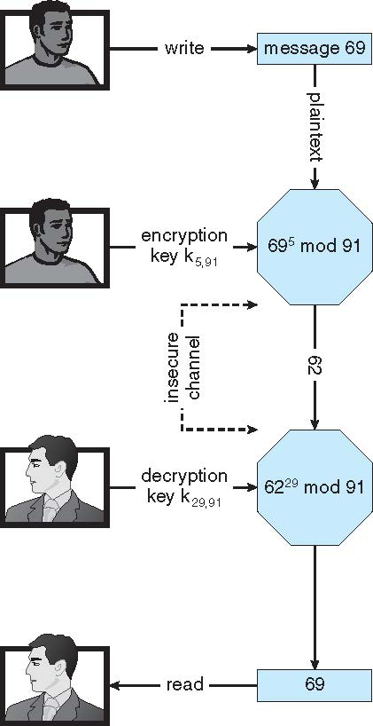
Encryption using RSA Asymmetric Cryptography

Slide 30
Thanks

